Slide 1
Chapter 22
Software Configuration Management
Slide Set to accompany
Software Engineering: A Practitioner’s Approach, 7/e
by Roger S. Pressman
Slides copyright © 1996, 2001, 2005, 2009 by Roger S. Pressman
For non-profit educational use only
May be reproduced ONLY for student use at the university level when used in conjunction with Software Engineering: A Practitioner's Approach, 7/e. Any other reproduction or use is prohibited without the express written permission of the author.
All copyright information MUST appear if these slides are posted on a website for student use.
These slides are designed to accompany Software Engineering: A Practitioner’s Approach, 7/e (McGraw-Hill 2009). Slides copyright 2009 by Roger Pressman and Bruce Link

Slide 2
Configuration Management
Configuration management is a discipline applying technical and administrative direction and surveillance to
  (a) identify and document functional and physical characteristics of a the configuration item,
  (b) control changes to those characteristics, and
  (c) record and report change processing and implementation status

Slide 3
The “First Law”
No matter where you are in the system life cycle, the system will change, and the desire to change it will persist throughout the life cycle.
Bersoff, et al, 1980
These slides are designed to accompany Software Engineering: A Practitioner’s Approach, 7/e (McGraw-Hill 2009). Slides copyright 2009 by Roger Pressman.

Slide 4
Purpose of
Configuration Management
A systematic approach to identify how to construct a software system
  allows us to know exactly what versions of the software have been delivered & where
A systematic approach to recording information about known problems, and what problems have been fixed in what releases
  means of ensuring that changes to a system are done in an organized and approved manner

Slide 5
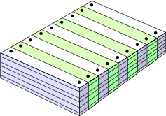
What Are These Changes?
changes in
business requirements
changes in
technical requirements
changes in
user requirements
other
documents
software models
Project
Plan
data
Test
code
These slides are designed to accompany Software Engineering: A Practitioner’s Approach, 7/e (McGraw-Hill 2009). Slides copyright 2009 by Roger Pressman.

Slide 6
Basic Activities of Configuration Management
(1) Configuration Identification
(2) Configuration Control
(3) Configuration Status Accounting
(4) Configuration Verification
(Covered on the rest of the slides)

Slide 7
SCM Elements
Component elements—a set of tools coupled within a file management system (e.g., a database) that enables access to and management of each software configuration item.
Process elements—a collection of procedures and tasks that define an effective approach to change management (and related activities) for all constituencies involved in the management, engineering and use of computer software.
Construction elements—a set of tools that automate the construction of software by ensuring that the proper set of validated components (i.e., the correct version) have been assembled.
Human elements—to implement effective SCM, the software team uses a set of tools and process features (encompassing other CM elements)
These slides are designed to accompany Software Engineering: A Practitioner’s Approach, 7/e (McGraw-Hill 2009). Slides copyright 2009 by Roger Pressman.

Slide 8
The SCM Process
Addresses the following questions …
How does a software team identify the discrete elements of a software configuration?
How does an organization manage the many existing versions of a program (and its documentation) in a manner that will enable change to be accommodated efficiently?
How does an organization control changes before and after software is released to a customer?
Who has responsibility for approving and ranking changes?
How can we ensure that changes have been made properly?
What mechanism is used to appraise others of changes that are made?
These slides are designed to accompany Software Engineering: A Practitioner’s Approach, 7/e (McGraw-Hill 2009). Slides copyright 2009 by Roger Pressman.

Slide 9

The SCM Process
These slides are designed to accompany Software Engineering: A Practitioner’s Approach, 7/e (McGraw-Hill 2009). Slides copyright 2009 by Roger Pressman.

Slide 10
(1) Configuration Identification
Identification of configuration items
  Variously called CI, SCI or CSCI by different people
Naming and numbering
Version identification
Baselines & milestones
Software structure
Relationships between SCIs

Slide 11
The Software Configuration
programs
documents
The pieces
data
These slides are designed to accompany Software Engineering: A Practitioner’s Approach, 7/e (McGraw-Hill 2009). Slides copyright 2009 by Roger Pressman.

Slide 12
What's a CI?
A collection of hardware or software elements treated as a unit for the purposes of configuration management
An aggregation of hardware/software that satisfies an end use function and is designated for configuration management.
Distinguish CI from configuration entities
  Configuration entities are the low level things that are managed in the configuration management system, typically individual files for software projects
Criteria for the selection of CIs include: size, unit replaceability, distributed architecture, separate schedules, change verifiability, safety

Slide 13
Naming and Numbering
Every configuration entity & item must be uniquely named &/or numbered
Naming conventions often embed a CI acronym in the names of all sublevel components
Name should suggest the function of the configuration entity
Name should suggest the type of entity (e.g. document, source code, object code, etc.)
Document numbers : significant versus random schemes (e.g. ES_MDA_RS_0001 or 602501)

Slide 14
Baselines
The IEEE (IEEE Std. No. 610.12-1990) defines a baseline as:
    A specification or product that has been formally reviewed and agreed upon, that thereafter serves as the basis for further development, and that can be changed only through formal change control procedures.
a baseline is a milestone in the development of software marked by
  the delivery of one or more software configuration items
  the approval of these SCIs that is obtained through a formal technical review
These slides are designed to accompany Software Engineering: A Practitioner’s Approach, 7/e (McGraw-Hill 2009). Slides copyright 2009 by Roger Pressman.

Slide 15
Baselines and Milestones
Part of CM is the decision about what will be in a baseline, and when the baselines will be established
Typical baselines for large systems are:
  functional baseline - system requirements established
  allocated baseline - software requirements established
  developmental configuration - design and code in progress
  product baseline - delivered system
Within the developmental configuration the contractor controls changes without needing customer approval.
Intermediate milestones could be:
  high level design configuration
  detailed design configuration
  unit tested configuration
  integration tested configuration
  system tested configuration

Slide 16
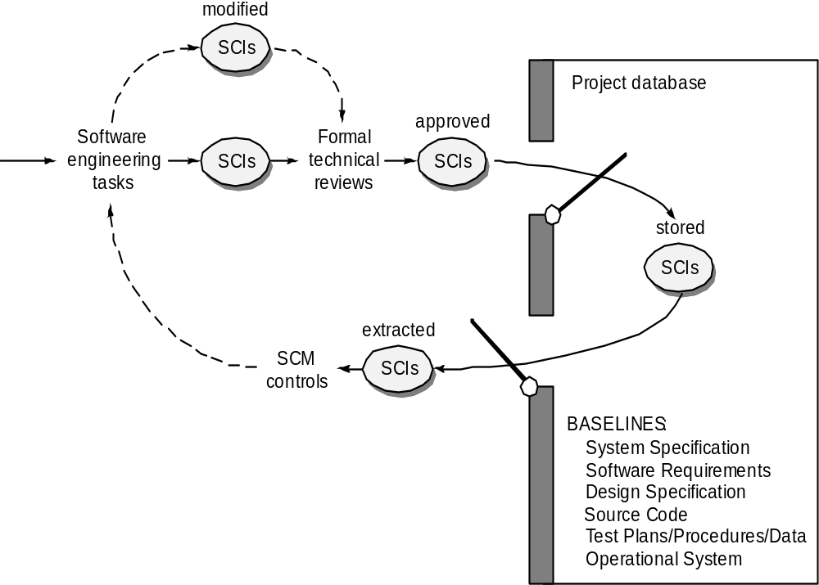
Baselines
These slides are designed to accompany Software Engineering: A Practitioner’s Approach, 7/e (McGraw-Hill 2009). Slides copyright 2009 by Roger Pressman.

Slide 17
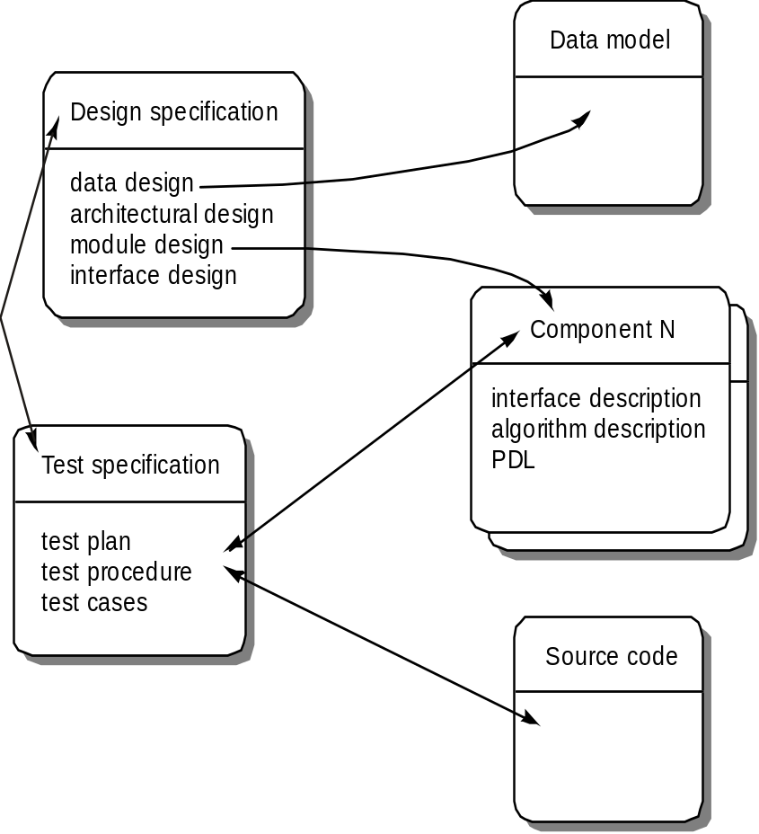
Software Configuration Objects
These slides are designed to accompany Software Engineering: A Practitioner’s Approach, 7/e (McGraw-Hill 2009). Slides copyright 2009 by Roger Pressman.

Slide 18
SCM Repository
The SCM repository is the set of mechanisms and data structures that allow a software team to manage change in an effective manner
The repository performs or precipitates the following functions [For89]:
  Data integrity
  Information sharing
  Tool integration
  Data integration
  Methodology enforcement
  Document standardization
These slides are designed to accompany Software Engineering: A Practitioner’s Approach, 7/e (McGraw-Hill 2009). Slides copyright 2009 by Roger Pressman.

Slide 19
Software & Documentation Repositories
Developmental configuration is usually set up as an on-line repositories or set of repositories
During development the software and associated documentation are promoted within the repository
  Successfully tested pieces move to higher repositories that indicate their status (conceptually at least)
At the end of development, the final software becomes the 'Product Baseline'
  Delivered to the customer
Developers can put software into the repository or get copies from it
  Can't delete or update anything in the repository without review and approval

Slide 20
Control Repositories
Control repositories are used to store the source code, documentation, and possibly the object code
Integration should only take place from the code in the control repository
Source Code Control system examples: RCS, CVS, CCC, Source Safe, ClearCase, Subversion
These systems have the advantage that they do 'delta' storage of changes, and so save memory space.

Slide 21
Control Repositories (cont.)
May have several integration repositories corresponding to different stages of integration
Working repository – developers’ working copies. Unit testing is done here - often in developers’ local directories
Integration-testing repository - Unit tested modules are released to this repository and integration testing is done from this
System-testing repository - All modules in the integration-testing repository are moved here upon successful completion of integration testing. Executables for system testing are built from this
Product Baseline - After acceptance testing, modules are moved into this repository

Slide 22
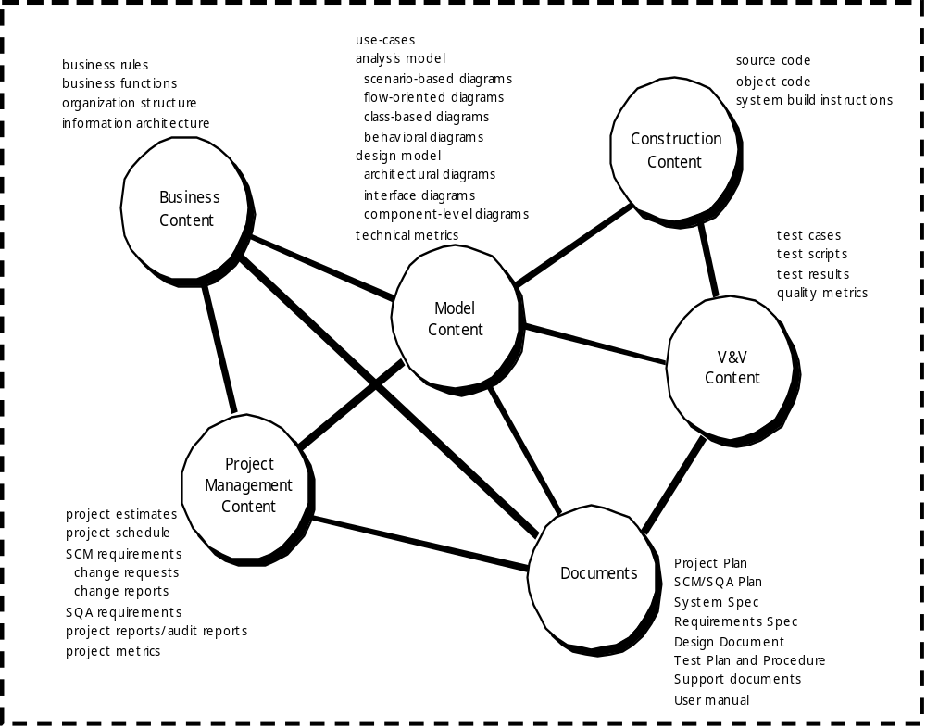
Repository Content
These slides are designed to accompany Software Engineering: A Practitioner’s Approach, 7/e (McGraw-Hill 2009). Slides copyright 2009 by Roger Pressman.

Slide 23
Repository Features
Versioning.
  saves all of these versions to enable effective management of product releases and to permit developers to go back to previous versions
Dependency tracking and change management.
  The repository manages a wide variety of relationships among the data elements stored in it.
Requirements tracing.
  Provides the ability to track all the design and construction components and deliverables that result from a specific requirement specification
Configuration management.
  Keeps track of a series of configurations representing specific project milestones or production releases. Version management provides the needed versions, and link management keeps track of interdependencies.
Audit trails.
  establishes additional information about when, why, and by whom changes are made.
These slides are designed to accompany Software Engineering: A Practitioner’s Approach, 7/e (McGraw-Hill 2009). Slides copyright 2009 by Roger Pressman.

Slide 24
Version Control
Version control combines procedures and tools to manage different versions of configuration objects that are created during the software process
A version control system implements or is directly integrated with four major capabilities:
  a project database (repository) that stores all relevant configuration objects
  a version management capability that stores all versions of a configuration object (or enables any version to be constructed using differences from past versions);
  a make facility that enables the software engineer to collect all relevant configuration objects and construct a specific version of the software.
  an issues tracking (also called bug tracking) capability that enables the team to record and track the status of all outstanding issues associated with each configuration object.
These slides are designed to accompany Software Engineering: A Practitioner’s Approach, 7/e (McGraw-Hill 2009). Slides copyright 2009 by Roger Pressman.

Slide 25
Version Identification
Each configuration entity must have an identifier that signifies its version.
  Usually an integer counting the versions from the first
SCIs require a release and version number.
  Release = major functional enhancement
  Version = release with defect fixes, e.g. release 1.03
  Sometimes have middle number for minor functional enhancements, e.g. 3.5.1
Documents should also have an issue and version identification.
  Issue = major release of an entire document
  Version = minor release where some pages have been changed

Slide 26
(2) Configuration Control
Baselines versus developmental configuration
Software & documentation libraries
Software problems (SPRs)
Engineering change proposals (ECPs)
Change records (CRs)
Specification change notices

Slide 27
Change Control
STOP
These slides are designed to accompany Software Engineering: A Practitioner’s Approach, 7/e (McGraw-Hill 2009). Slides copyright 2009 by Roger Pressman.

Slide 28
Baselines Versus Developmental Configuration
Baselines are customer controlled.
  Changes to a baseline require customer review / approval
Baseline changes often take a long time
  Several months is common on large projects
Developmental configuration represents the progressive development of the software by the contractor
  Consists of a series of 'intermediate baselines'
  Not usually controlled by the customer
Changes to the developmental configuration should be controlled
  Less formal and doesn't involve the customer

Slide 29
Change Control Process—I
need for change is recognized
change request from user
developer evaluates
change report is generated
change control authority decides
request is queued for action
change request is denied
user is informed
change control process—II
These slides are designed to accompany Software Engineering: A Practitioner’s Approach, 7/e (McGraw-Hill 2009). Slides copyright 2009 by Roger Pressman.

Slide 30
Change Control Process-II
assign people to SCIs
check-out SCIs
make the change
review/audit the change
establish a “baseline” for testing
change control process—III
These slides are designed to accompany Software Engineering: A Practitioner’s Approach, 7/e (McGraw-Hill 2009). Slides copyright 2009 by Roger Pressman.

Slide 31
Change Control Process-III
perform SQA and testing activities
check-in the changed SCIs
promote SCI for inclusion in next release
rebuild appropriate version
review/audit the change
include all changes in release
These slides are designed to accompany Software Engineering: A Practitioner’s Approach, 7/e (McGraw-Hill 2009). Slides copyright 2009 by Roger Pressman.

Slide 32
Software Problem Reports
No change should be made to controlled items without a reason that has been reviewed and approved by appropriate authorities
One good reason for making a change is to remove a defect from the software
Software Problem Reports (SPRs) are used to describe a problem, so that
  it is reviewed,
  its impact is analyzed,
  a decision is made about whether to fix or not
A "problem" is a record that the system does not meet specifications in some way

Slide 33
Engineering Change Proposals
Another reason for making a change is that the specifications need to be modified
Here there is no "problem" - the existing software meets the existing specification.
  if specification needs to change the software must change with it
Engineering change proposals (ECPs) are used to identify changes to specifications.
Like SPRs, they must be reviewed, their impact analyzed, and a decision made about whether to make the change or not

Slide 34
Change Records
SPRs and ECPs are used to describe the reasons for making a change
  don't describe the change itself
Once they are assigned to developers, they must describe how the change is going to be made
Reviewers can then assess whether the change will impact anything else, and whether the proposed solution is likely to succeed
A Change Record identifies
  the configuration entities that will be changed,
  the SPRs and ECPs satisfied by the change, and
  a short description of the change itself

Slide 35
Configuration Control Board (CCB)
On many projects, there is a need to establish a group to evaluate configuration changes
  on small projects this may be handled by the technical manager and quality assurance engineer
The CCB is be responsible for evaluating impacts of changes
  including any side effects or impacts on other parts of the system
To do this, it should have technical, QA, and management representatives.
The CCB approves or rejects proposed changes
  Can generate Engineering Change Orders (ECO) to indicate a change should be made

Slide 36
(3) Configuration Status Accounting
Problem status reports
  May be listed by priority, usually just want a summary for management (one or two lines per problem)
Change status reports
  Also want by priority with one or two lines per problem
Version Description Documents (VDD)
  Similar to release notes
  Identifies relevant requirements, change notices, wavers, discrepancies, known defects, workarounds

Slide 37
Status Accounting
Change
Reports
Change
Requests
ECOs
SCIs
Status Accounting
Reporting
These slides are designed to accompany Software Engineering: A Practitioner’s Approach, 7/e (McGraw-Hill 2009). Slides copyright 2009 by Roger Pressman.

Slide 38
(4) Configuration Verification
Incoming inspection
In-process audits
Functional configuration audit
Physical configuration audit
Outgoing inspection

Slide 39
Auditing
Change
Requests
SQA
Plan
SCIs
SCM Audit
These slides are designed to accompany Software Engineering: A Practitioner’s Approach, 7/e (McGraw-Hill 2009). Slides copyright 2009 by Roger Pressman.

Slide 40
Incoming Inspections
Every tangible item received should be identified with a sticker and number and catalogued
Received documents are often copied and the original is locked away
Received change notices are copied and distributed to owners of the affected documents
Received software is checked to see that all parts have been received
  Sometimes projects have someone responsible for testing that the software works before using it
  Especially important for tool or Operating System upgrades

Slide 41
In-process Audits
Periodically have to check the development libraries to make sure that they are in good condition.
  All materials are under control,
  Statuses are correct,
  Actual configuration entities match what the system thinks are there

Slide 42
Functional Configuration Audit
Sometimes done before establishing the Product Baseline
Checks that the SCI(s) as-built satisfies all specified functional requirements
  By comparing test reports against the specifications
Typical materials reviewed include:
  Version Description Document (or release notes), Software Requirements Specifications, Interface Requirements Specifications, nonconformance status reports, test reports, ECPs, waivers, and verification reports

Slide 43
Physical Configuration Audit
Last thing sometimes done before establishing the Product Baseline
Checks that the SCI(s) as-built satisfies the specified design
  By comparing code and test reports against the design specifications
Typical materials reviewed include:
  Version Description Document (or release notes), Software Design Document, Interface Design Document, nonconformance status reports, test reports, ECPs, waivers, and verification reports

Slide 44
Outgoing Inspection
This inspection is done to ensure that the software is ready to deliver:
  All software has been correctly identified,
  Has been written to the deliverable media (tape, disk, etc.),
  All deliverable media have been labelled,
  All associated documentation is included,
  An accurate VDD is included,
  All materials have been packaged properly
  Shipping labels are correct

Slide 45
SCM for Web Engineering-I
Content.
  A typical WebApp contains a vast array of content—text, graphics, applets, scripts, audio/video files, forms, active page elements, tables, streaming data, and many others.
  The challenge is to organize this sea of content into a rational set of configuration objects (Section 27.1.4) and then establish appropriate configuration control mechanisms for these objects.
People.
  Because a significant percentage of WebApp development continues to be conducted in an ad hoc manner, any person involved in the WebApp can (and often does) create content.
These slides are designed to accompany Software Engineering: A Practitioner’s Approach, 7/e (McGraw-Hill 2009). Slides copyright 2009 by Roger Pressman.

Slide 46
SCM for Web Engineering-II
Scalability.
  As size and complexity grow, small changes can have far-reaching and unintended affects that can be problematic. Therefore, the rigor of configuration control mechanisms should be directly proportional to application scale.
Politics.
  Who ‘owns’ a WebApp?
  Who assumes responsibility for the accuracy of the information on the Web site?
  Who assures that quality control processes have been followed before information is published to the site?
  Who is responsible for making changes?
  Who assumes the cost of change?
These slides are designed to accompany Software Engineering: A Practitioner’s Approach, 7/e (McGraw-Hill 2009). Slides copyright 2009 by Roger Pressman.

Slide 47
Content Management-I
The collection subsystem encompasses all actions required to create and/or acquire content, and the technical functions that are necessary to
  convert content into a form that can be represented by a mark-up language (e.g., HTML, XML
  organize content into packets that can be displayed effectively on the client-side.
The management subsystem implements a repository that encompasses the following elements:
  Content database—the information structure that has been established to store all content objects
  Database capabilities—functions that enable the CMS to search for specific content objects (or categories of objects), store and retrieve objects, and manage the file structure that has been established for the content
  Configuration management functions—the functional elements and associated workflow that support content object identification, version control, change management, change auditing, and reporting.
These slides are designed to accompany Software Engineering: A Practitioner’s Approach, 7/e (McGraw-Hill 2009). Slides copyright 2009 by Roger Pressman.

Slide 48
Content Management-II
The publishing subsystem extracts from the repository, converts it to a form that is amenable to publication, and formats it so that it can be transmitted to client-side browsers. The publishing subsystem accomplishes these tasks using a series of templates.
Each template is a function that builds a publication using one of three different components [BOI02]:
  Static elements—text, graphics, media, and scripts that require no further processing are transmitted directly to the client-side
  Publication services—function calls to specific retrieval and formatting services that personalize content (using predefined rules), perform data conversion, and build appropriate navigation links.
  External services—provide access to external corporate information infrastructure such as enterprise data or “back-room” applications.
These slides are designed to accompany Software Engineering: A Practitioner’s Approach, 7/e (McGraw-Hill 2009). Slides copyright 2009 by Roger Pressman.

Slide 49
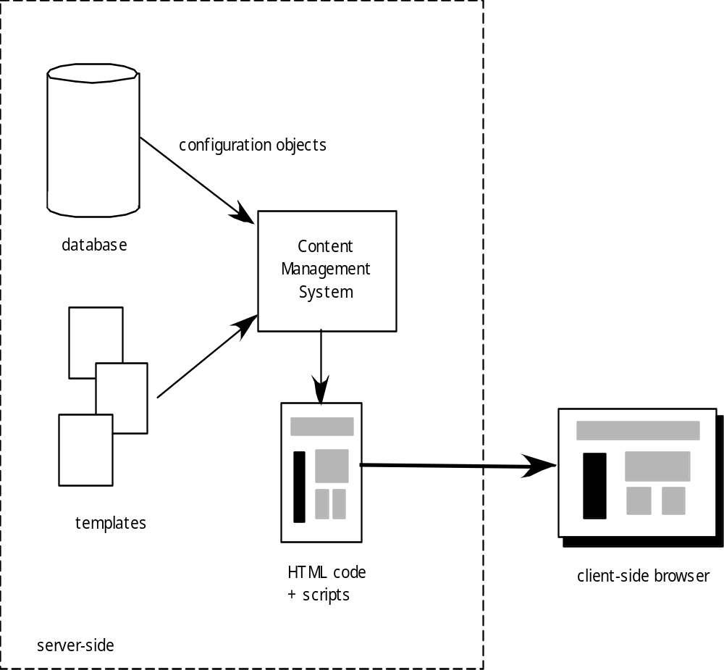
Content Management
These slides are designed to accompany Software Engineering: A Practitioner’s Approach, 7/e (McGraw-Hill 2009). Slides copyright 2009 by Roger Pressman.

Slide 50
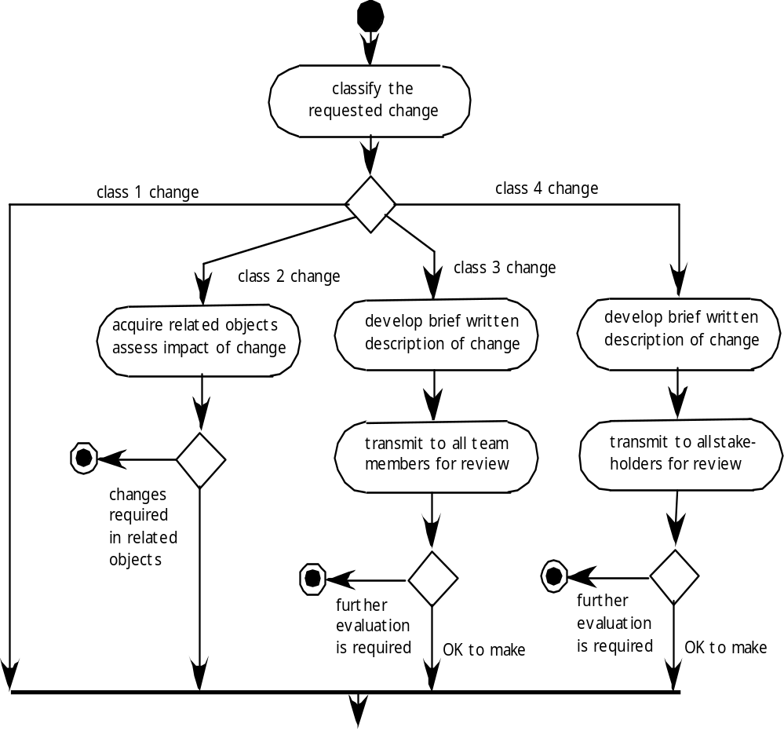
Change Management for WebApps-I
These slides are designed to accompany Software Engineering: A Practitioner’s Approach, 7/e (McGraw-Hill 2009). Slides copyright 2009 by Roger Pressman.

Slide 51
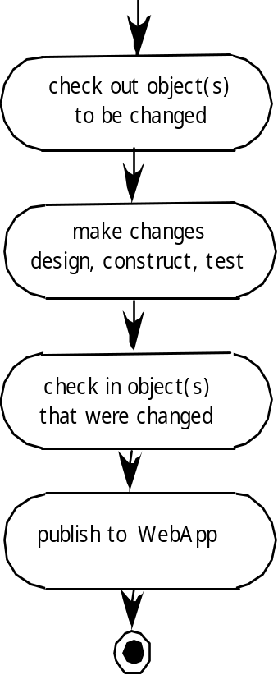
Change Management for WebApps-II
These slides are designed to accompany Software Engineering: A Practitioner’s Approach, 7/e (McGraw-Hill 2009). Slides copyright 2009 by Roger Pressman.

